Slide 1
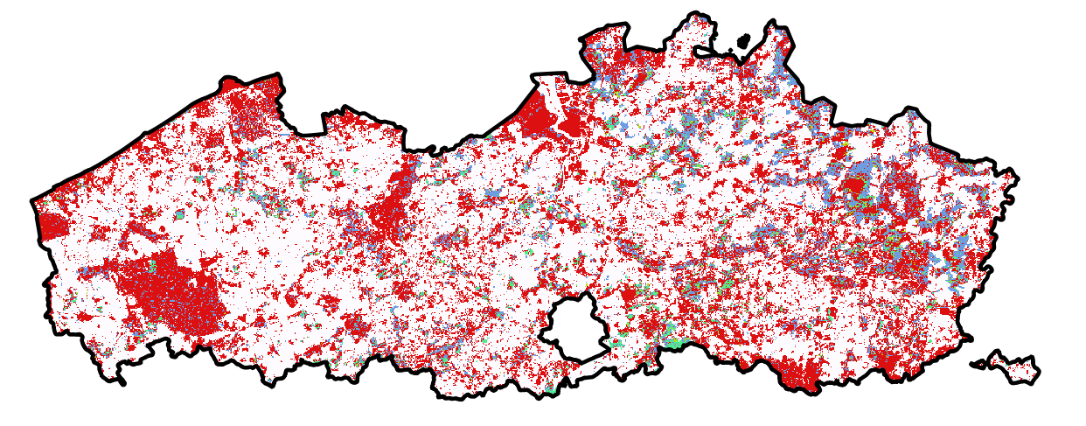
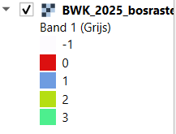

Slide 2
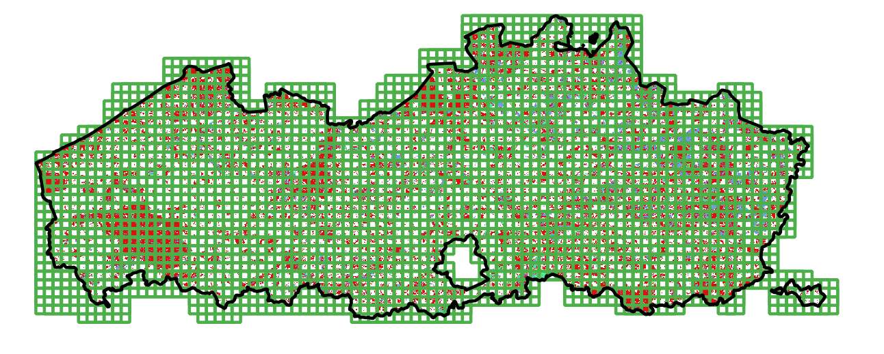
1 tile = 512 x 512 pixels (5120 meter), met h/v overlap van 256 meter

Slide 3
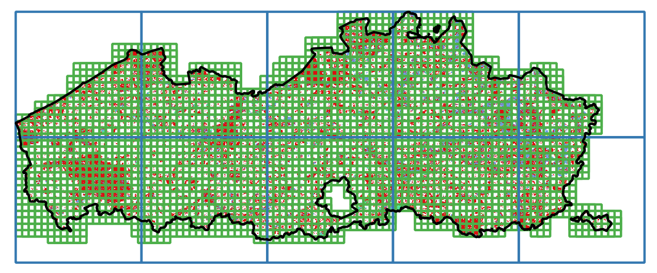
Indeling in 10 spatiale blokken

Slide 4
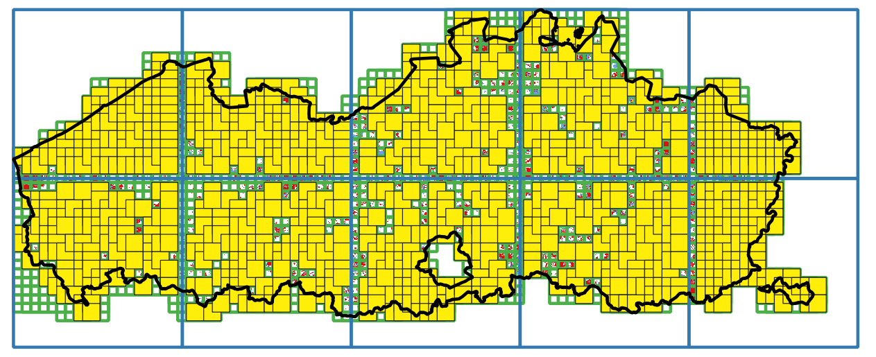
Indeling in 10 spatiale blokken
Steekproef van 100 tiles per blok die volledig in een blok zich bevinden en die niet “leeg” zijn (maar 76 zijn er gevonden voor noord-limburg)

Slide 5
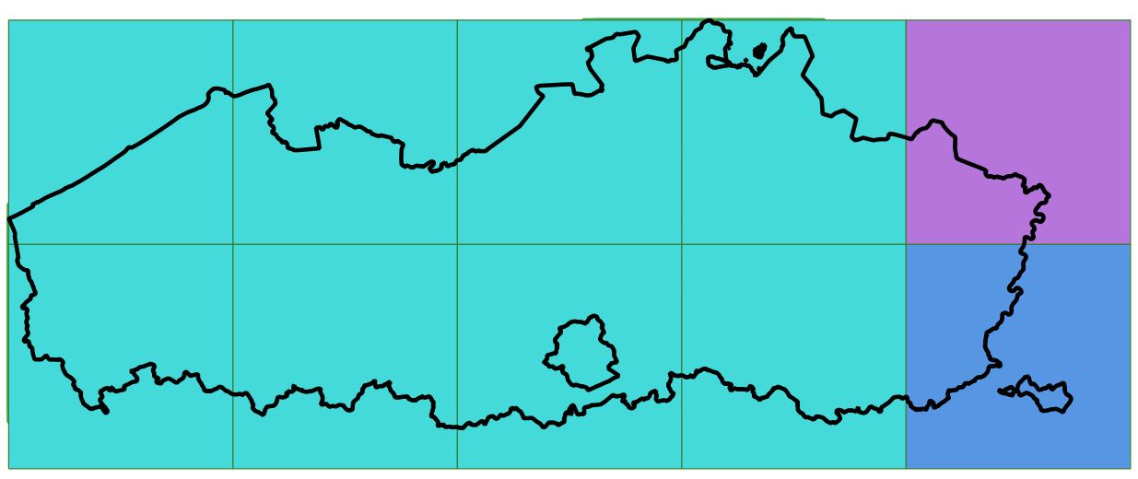
Hoe model nu trainen, tunen/valideren, testen en deployen?
10% validatieset
(voor hyperparameter tuning, model selectie)
10% testset
(voor model evaluatie)
80% trainingset
Deployement op alle gebieden.
Indeling kan random of niet random zijn.

Slide 6
Hoe model nu trainen, tunen/valideren, testen en deployen?
10% validatieset
(voor hyperparameter tuning, model selectie)
10% testset
(voor model evaluatie)
80% trainingset
Deployement op alle gebieden.
Indeling kan random of niet random zijn.
x keer, want training in deel learning training is deels stochastich
Verdeling van “optimale” hyperparameterset
Verdeling van de accuraatheid op trainings-, validatie- en testset.

Slide 7
Hoe model nu trainen, tunen/valideren, testen en deployen?
10% validatieset
(voor hyperparameter tuning, model selectie)
10% testset
(voor model evaluatie)
80% trainingset
Deployement op alle gebieden.
Indeling kan random of niet random zijn.
x keer, want training in deel learning training is deels stochastich
Verdeling van “optimale” hyperparameterset
Verdeling van de accuraatheid op trainings-, validatie- en testset.

Slide 8
https://arxiv.org/html/2502.03480v2
https://arxiv.org/html/2502.03480v1

Slide 9
The Recommended Workflow (Step-by-Step)
Step 1: Isolate your Final Test Block
Take 1 block and put it completely to the side. Under no circumstances does any model see this block during tuning or training. It acts as your final "sanity check" before deployment. You now have 9 remaining blocks.
Step 2: Leave-One-Block-Out (LOBO) Cross-Validation & Tuning
On your 9 remaining blocks, perform a 9-fold Leave-One-Block-Out CV to tune your hyperparameters (e.g., learning rate, network layers, architecture choice).
Iteration 1: Train on Blocks 1–8. Validate on Block 9.
Iteration 2: Train on Blocks 1–7 + 9. Validate on Block 8.
... (Repeat 9 times).
Calculate: Average the validation performance metrics across all 9 runs. The hyperparameter combination with the highest average score wins.
Step 3: Evaluate on the Pristine Test Set
Take the winning hyperparameter settings from Step 2. Train a model on all 9 blocks combined and test its accuracy on your hidden 10th block.
If this score matches your CV score, it proves your model generalizes beautifully to new geographic regions.
Step 4: Final Retraining and Deployment 🚀
Option A (Standard Practice): Retrain your model with the chosen hyperparameters on all 10 blocks combined and deploy. By including the 10th block, you give the neural network the maximum possible spatial context, features, and geography before it goes live.
Option B (Conservative Deep Learning Alternative): If your deep learning model is prone to wild training instability, or you cannot reliably figure out the exact number of epochs to train for without a validation set, deploy the final model from Step 3 (the one trained on 9 blocks).
Why you should NOT do the other options
❌ Don't: "Deploy the 10 separate cross-validated models as an ensemble"
While deploying 10 models (an ensemble) can yield small performance gains, it is highly discouraged for deep learning pipelines. [1]
The Cost: Deep learning models are massive. Deploying, hosting, and running inference on 10 separate neural networks in production multiplies your cloud computing, storage, and API latency costs by 10x.
The Complexity: You would have to pass every new piece of geographical data through 10 models and compute an average prediction, complicating your serving pipeline.
❌ Don't: "Deploy a single fold's model without retraining"
If you just pick the model from Fold 1 (trained on 8 blocks) and deploy it, you are actively wasting 10% to 20% of your data. In deep learning, data is king. Leaving out entire geographic regions means your model will go to production completely blind to the land features, climates, or urban layouts inherent to those excluded blocks.
To help refine your final step, tell me:
Is your deep learning model computationally expensive / long to train, making a 9-fold loop difficult?
Do you use Early Stopping to prevent overfitting, or do you train for a fixed number of epochs?

